Slide 1


Introduction to databases and SQL
Women for Women Workshop
Alexandra Shtromberg, procurement analytics @Sievo

Slide 2
Agenda
Introductions
Pure theory – database concept
Case study: Designing our database
Break (10 min)
Let’s query each other databases!

Slide 3
Introductions
Name
Have you worked with databases?
What do you hate about databases?
What do you want to learn today?

Slide 4
Database – starting from a table
All data is held in tables, which are made up of rows and columns.
Each field has specific data type and constraints
All tables should have a primary key – a unique identifier of a row, that cannot be NULL and rarely changes.
Store_id is an automatically generated PRIMARY KEY
max. 50 symbols

Slide 5
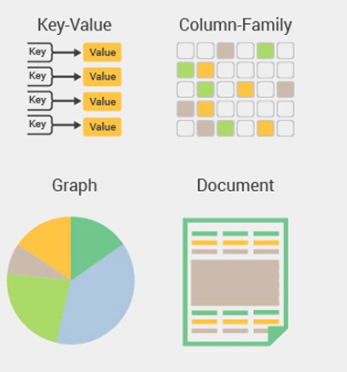
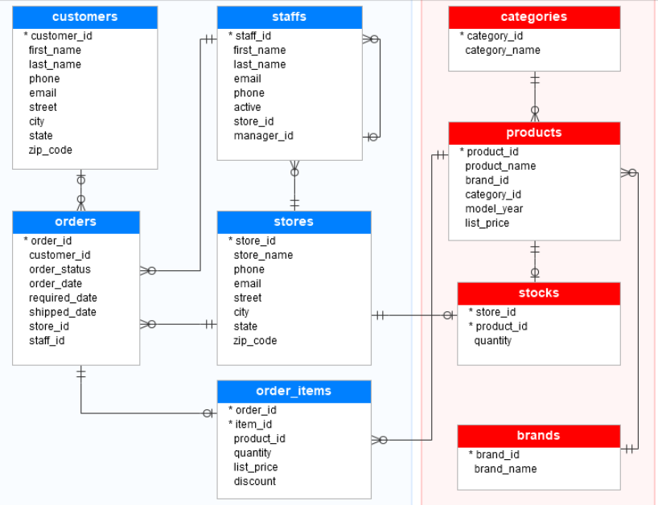
Databases
Non-relational
Relational
https://github.com/UWCoffeeNCode/resources/wiki/SQL-and-NoSQL-Databases

Slide 6
Multiple tables in a relational database
Tables are related to each other
Database diagrams to track relations
Database relations
One-to-one
One-to-many
Many-to-many
Primary and foreign keys

Slide 7
Normal forms simply explained
1NF | each cell in a table must contain only one piece of information no duplicate rows
2NF | -value of any field should rely on (be functionally dependent on) the primary key
3NF | -no fields are transitionallly dependent on each other
if something is not in 1NF, it is not in 2NF or 3NF either.
Each additional Normal Form = everything that the lower normal forms had + sth extra

Slide 8
Normal forms simply explained – cont’d
StudentID | StudentName | City | Postal code | CourseCode | CourseName | Grade
0140901 | Alexandra |  |  | 001 | SQL | 4
0140902 | Anu |  |  | 001 | SQL | 4
0140903 | Anna |  |  | 002 | Database theory | 5

Slide 9
Database – other objects
Stored procedures (reusable SQL code – e.g. to convert USD to EUR)
Views (virtual table getting data from table)
Indexes (“bookmarks” for parsing data)
Triggers (stored procedures running when specific actions occur within a database)

Slide 10
Case study: design a database!
Each group receives a use case & materials to brainstorm
25 minutes to build a database!

Slide 11
Basic database design cases – pick one or add your own!
Student register
Dog kindergarten database
Bike store
Nail studio register
Employee expense claim system
Recipe management app

Slide 12
Let’s check our databases with SQL!
Short presentations of projects
Challenges in designing databases
CREATE, INSERT, SELECT statements in SQL

Slide 13
SQL
Syntax does not update over time (almost…)
Easy to learn and use
Required for positions in back-end, data science, business analysis and even finance controlling
SQL allows to:
Create databases and its objects
Explore and manipulatedata
Administer database (permissions, etc)

Slide 14
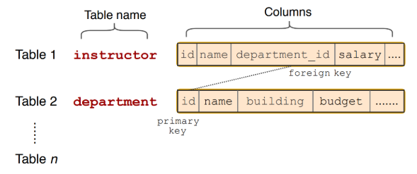
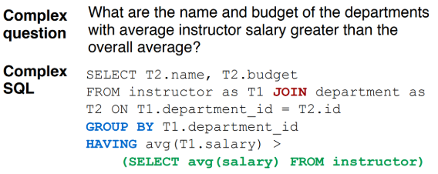
SQL syntax – just like a human language

Slide 15



Join us on social media
wfwworkshop.slack.com
Women for Women workshop Finland
facebook.com/WfWworkshopFinland

